Slide 1


Alpha Phi Omega
Chi Chapter at UCLA
Alpha Lambda / Yuna Choi Term, Meeting 8
May 28, 2014
www.apo-x.org

Slide 2
Agenda
1. Officer Updates and Announcements
2. Chapter Business
3. Last Announcements

Slide 3
President
Jessica Suhardjo
president@apo-x.org
Executive Committee
excomm@apo-x.org

Slide 4
General Info
Etiquette at events
Be mindful
Be considerate

Slide 5
Last Gamer’s Guide Tip
Thousands of candles can be lighted from a single candle, and the life of the candle will not be shortened. Happiness never decreases by being shared.
- Buddha

Slide 6

THANKS GUYS!

Slide 7
Administrative VPs
Joseph Chan & Nicola Yip
admin@apo-x.org

Slide 8
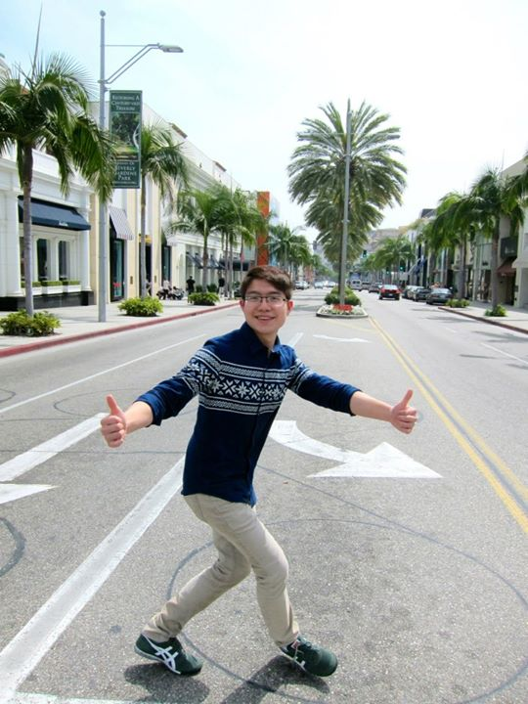
Brothers of Chi Chapter
“The best time to wear a striped sweater...is all the time!”
Submitted by Brian Lee

Slide 9
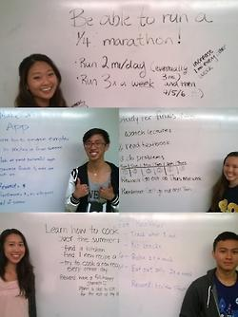
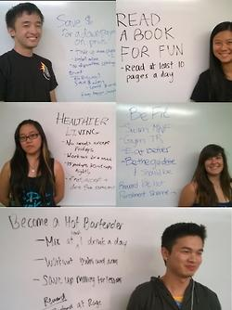

Slide 10
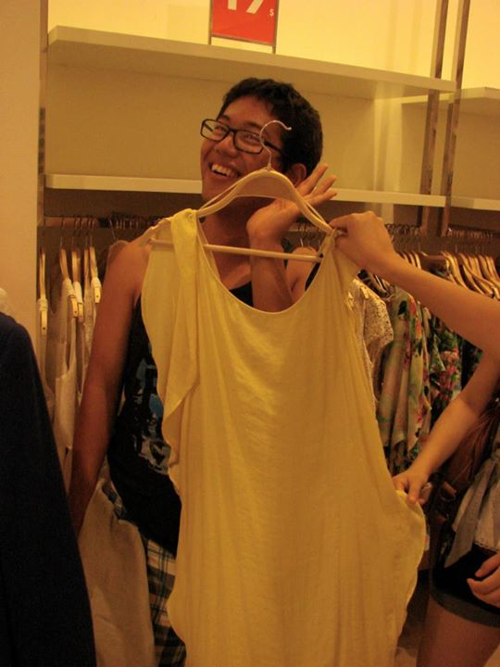
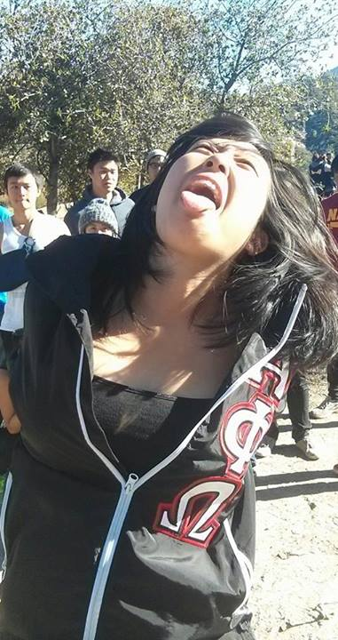
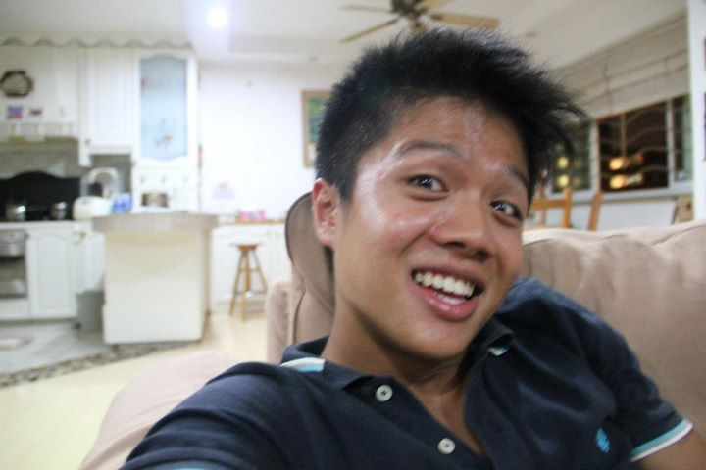
Thank you to our committees!
Alumni Liason
Social Media Committee

Slide 11

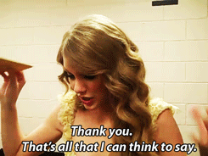

Slide 12
Membership VPs
Jeremy Gozzip & Melissa Ma
membership@apo-x.org

Slide 13
Requirements!
DUE TONIGHT AT 11:59PM.

Slide 14
Senior Speakers
Please submit VIDEOS of 1:30 MAX to MVP e-mail by THURSDAY at NOON.
pls.

Slide 15
Shoutout Book!
Dear Tina, Thank you so much for swiping Omegas in for the past two weeks for dorm dinners! We appreciate it so much and hope that you have enough swipes to last you to the end of the quarter as well lols. Thanks again. -Judy and Sam
Dear Omegas, We are very proud and happy with how far we’ve come and how hard we’ve worked this term. Thank you for cooperating with us and thanks for all the laughs! This term wouldn’t have been as great as it is without you guys. Love, Judy and Sam

Slide 16
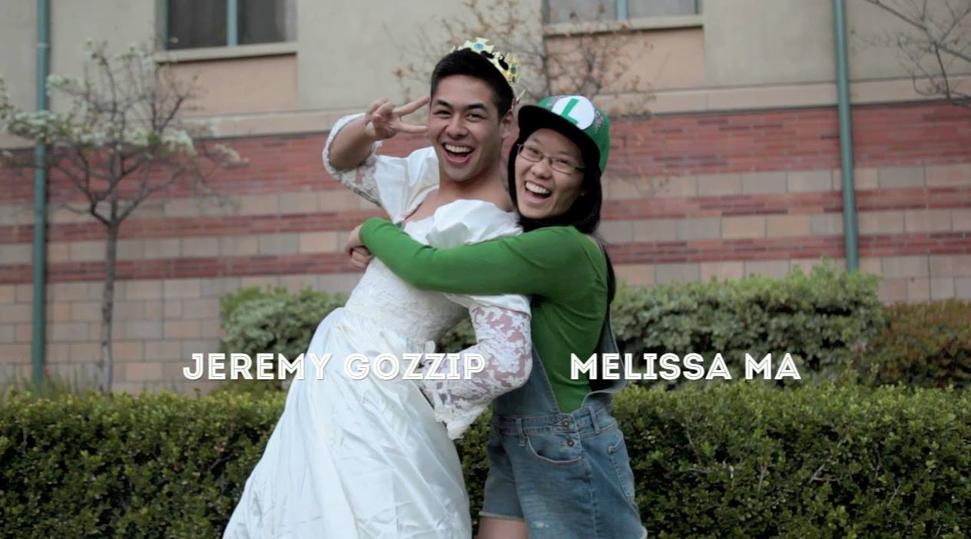
Thank you!
THANK YOU ALL FOR A GREAT TERM <3
xoxo. membership. thnks fr th mmrs.

Slide 17
Service VPs
William Nguyen & Jade Vo
apoxservice@gmail.com

Slide 18
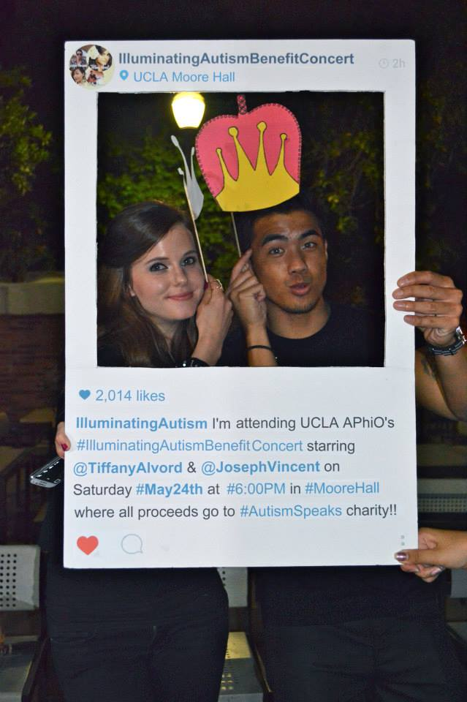
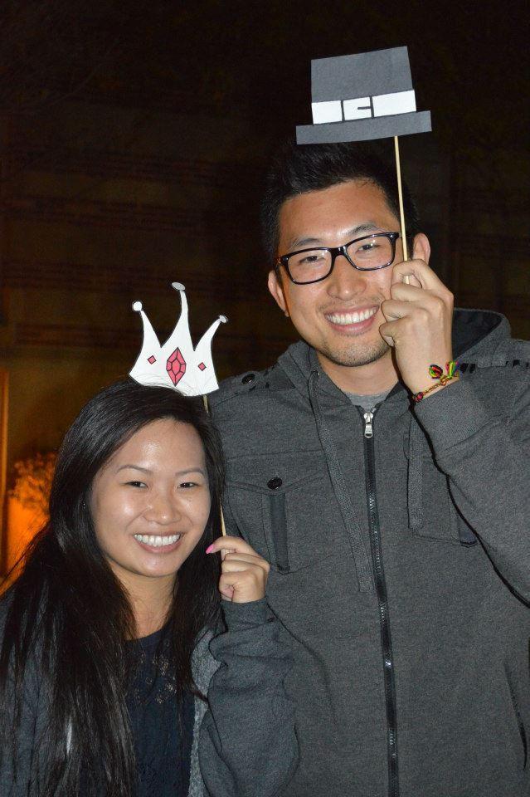
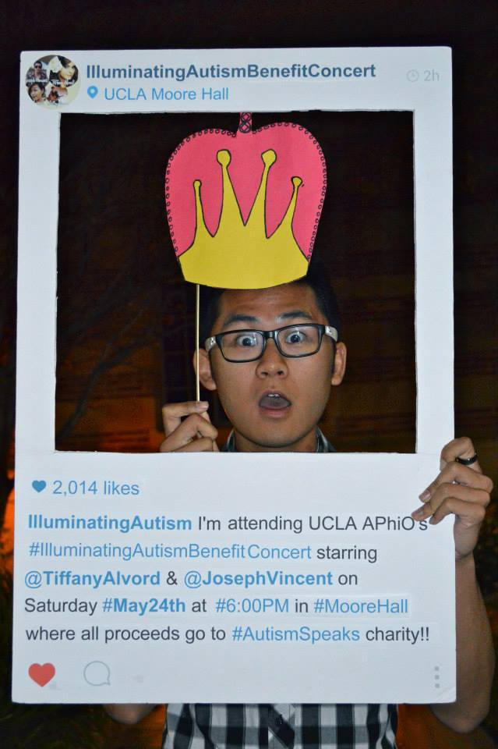
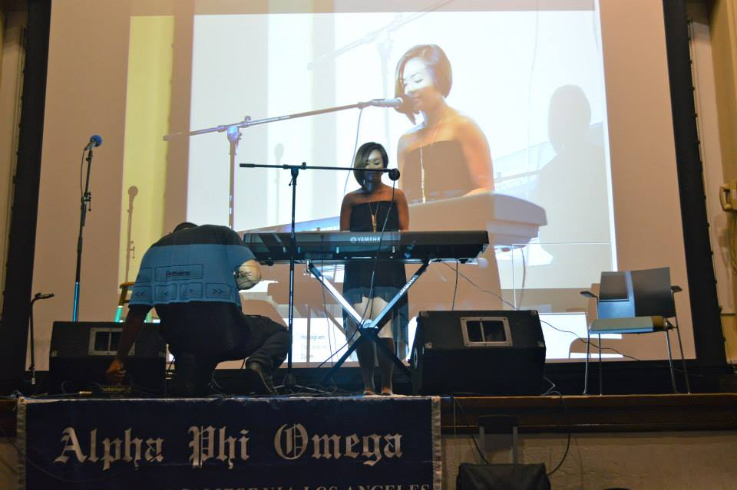
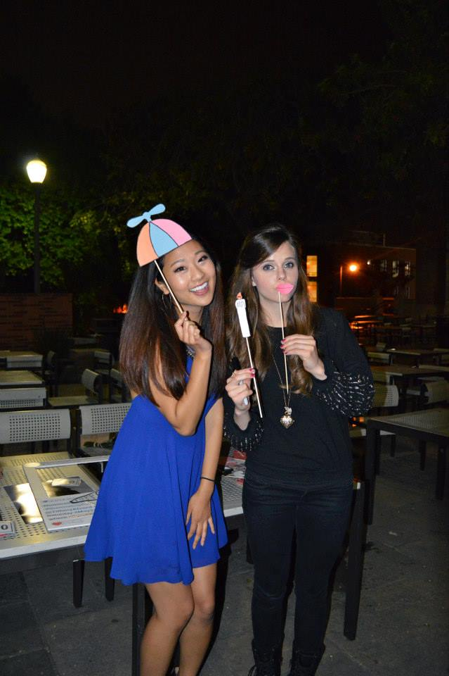
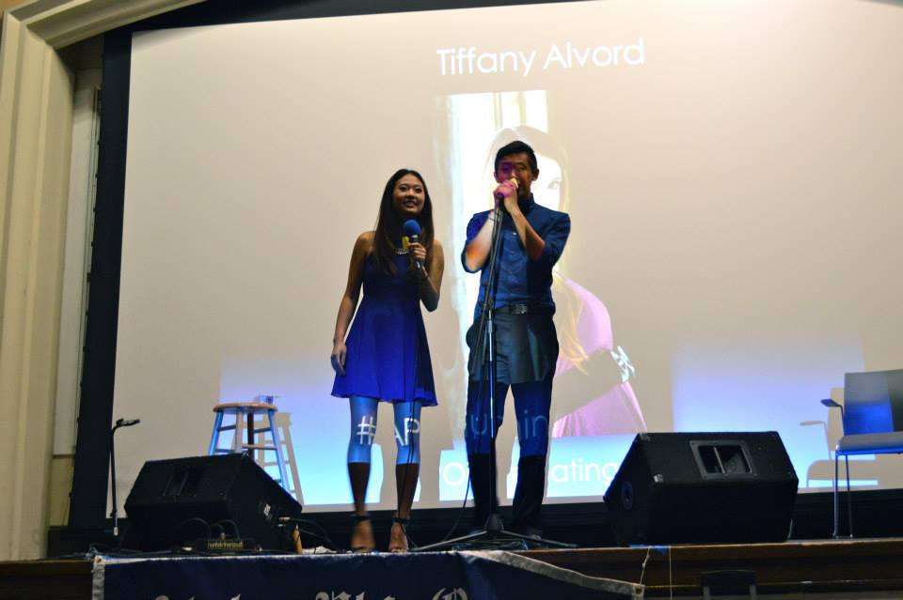
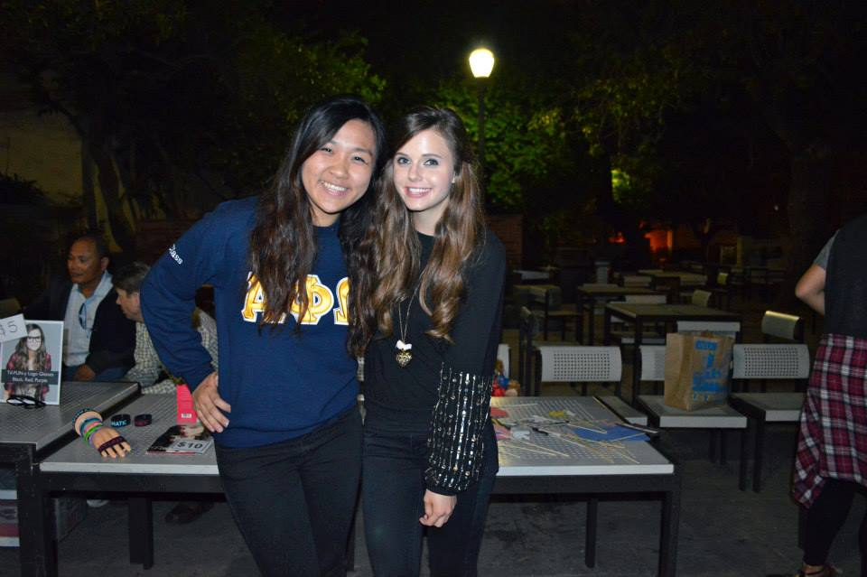
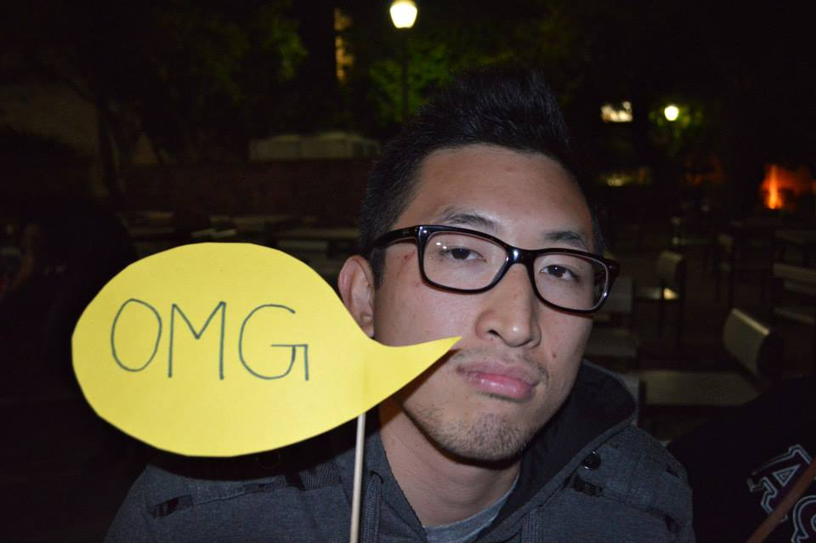
BENEFIT CONCERT
THANK YOU ALL SO MUCH FOR THE SUPPORT <3

Slide 19

The Good News
Got our name out!
The concert was enjoyable!
Everything went pretty smoothly!
No major issues!

Slide 20

The Bad News...
We didn’t break even...

Slide 21

SBotW
And the LAST Service Brothers of the Week are…

Slide 22
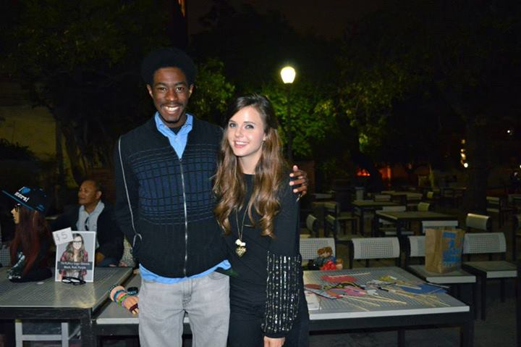
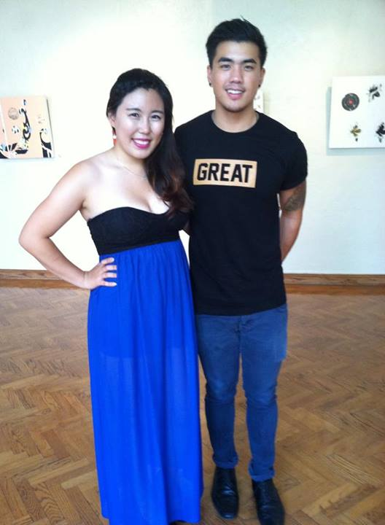

Service Brother of the Week!
SARAH YI!
ABRAM SUMMERS!

Slide 23

Special Thanks!
The term is over… :(
THANK YOU SO MUCH COMMITTEES!

Slide 24
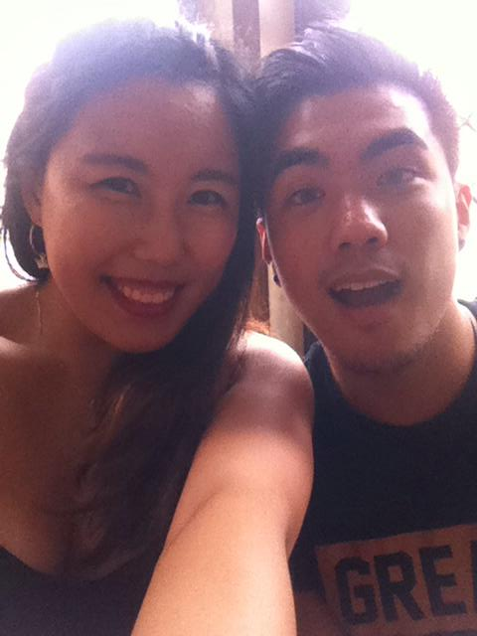
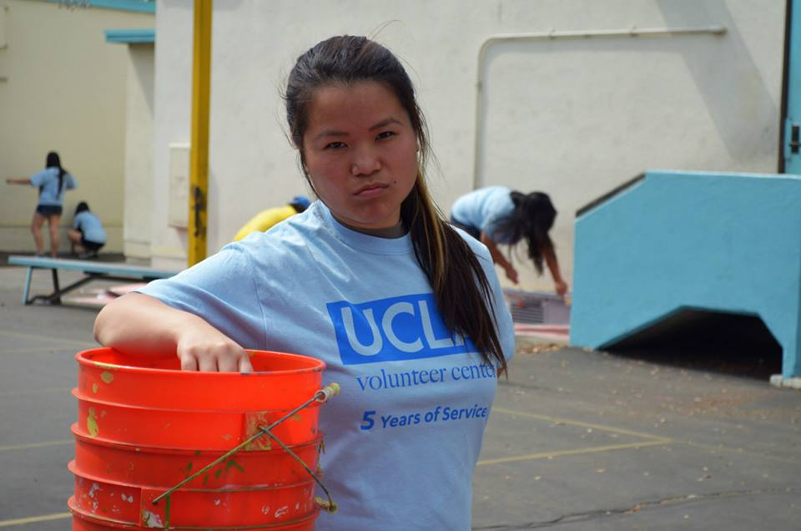
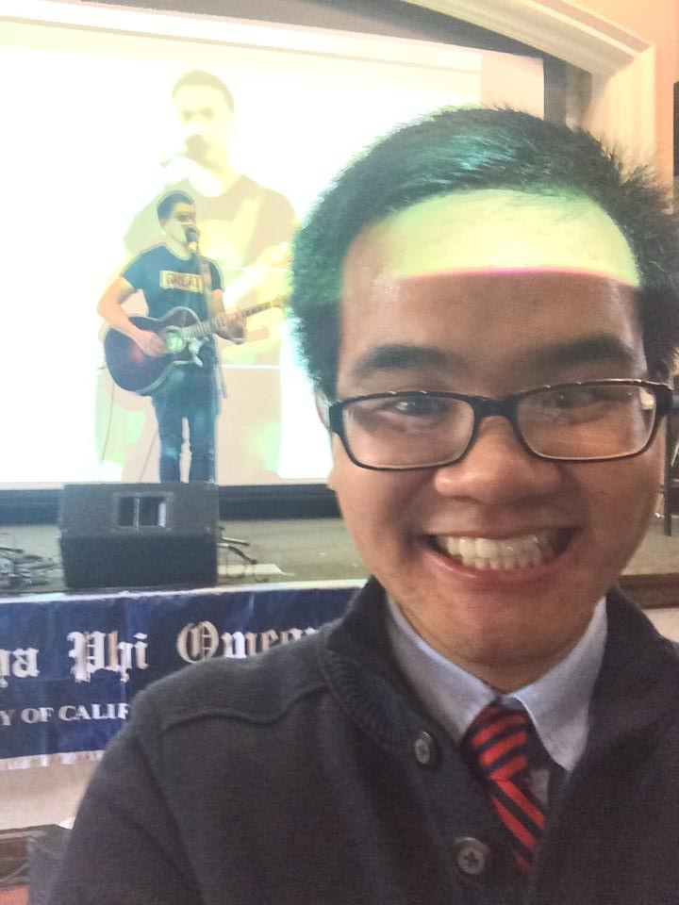
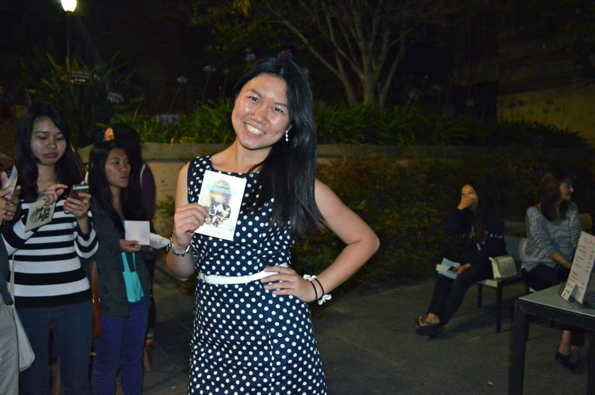
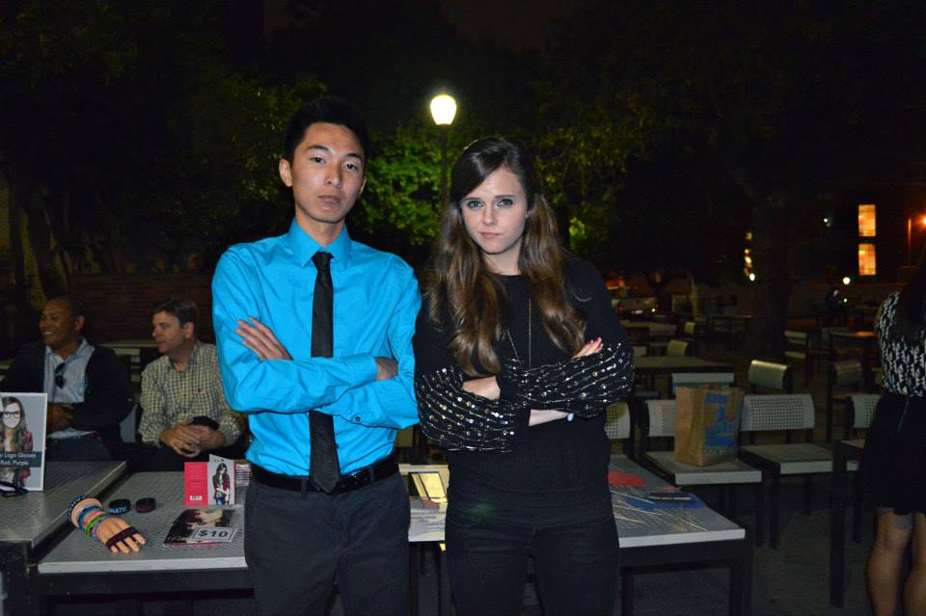
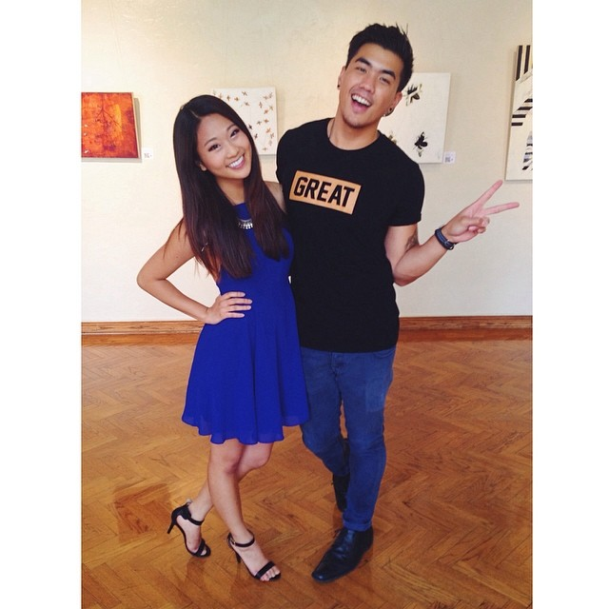
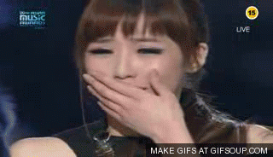
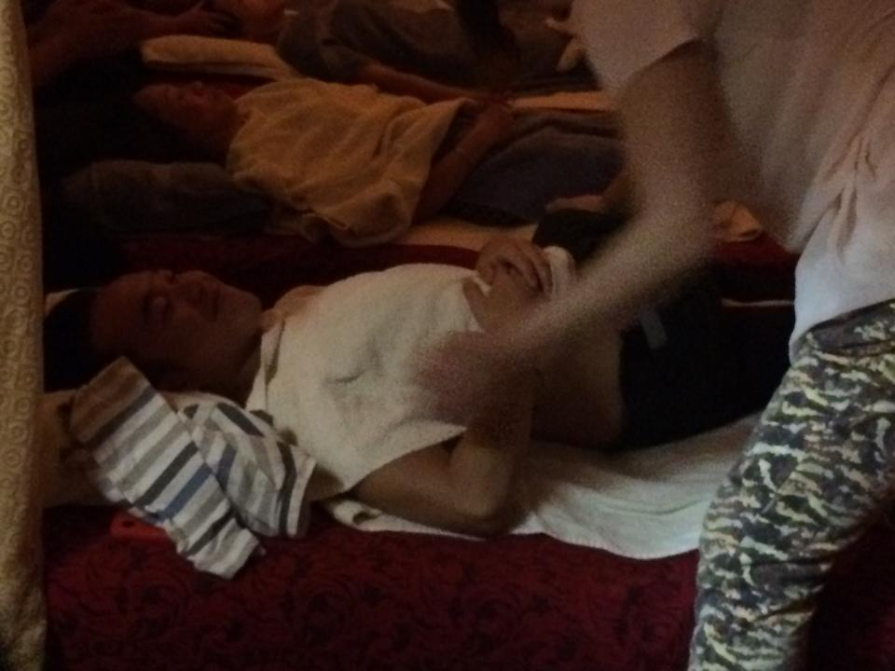
Benefit Concert Committee!

Slide 25
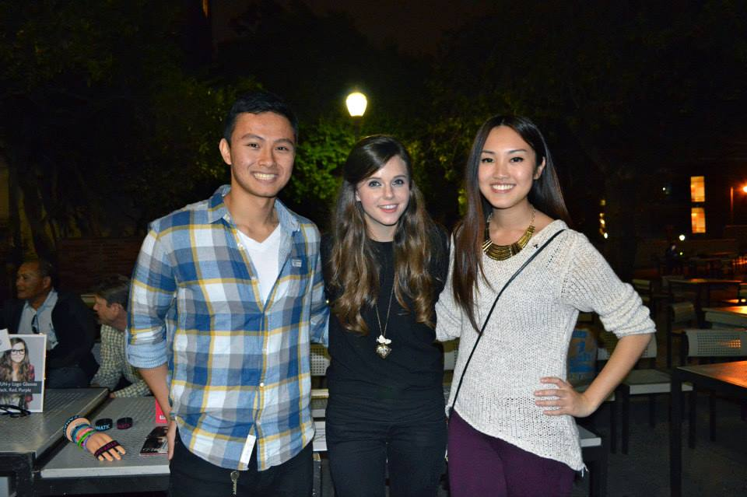
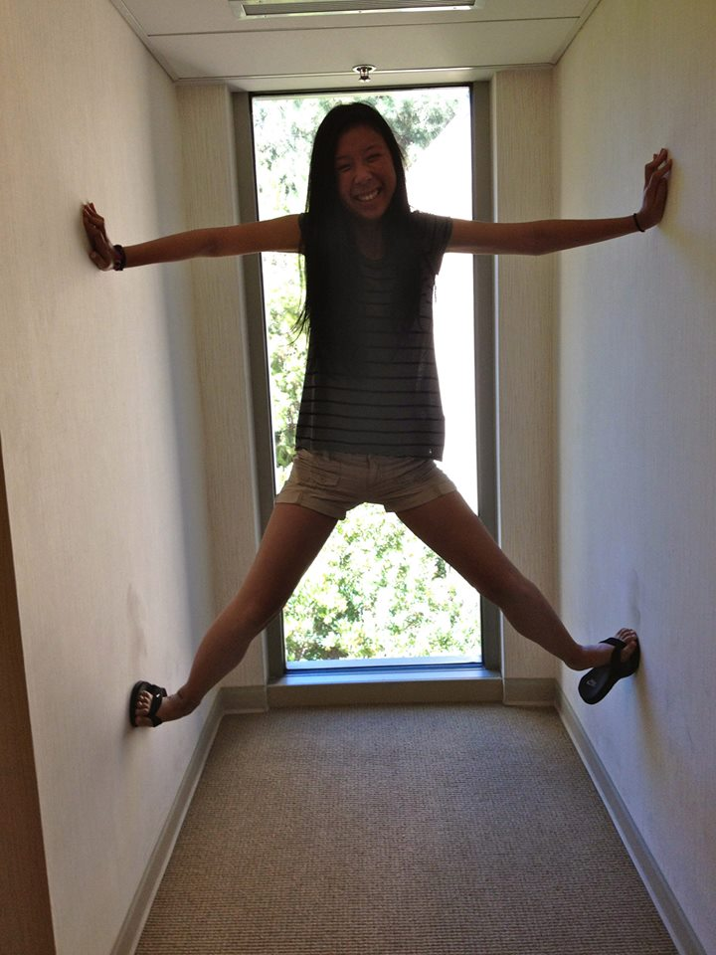
Decorations Committee!

Slide 26
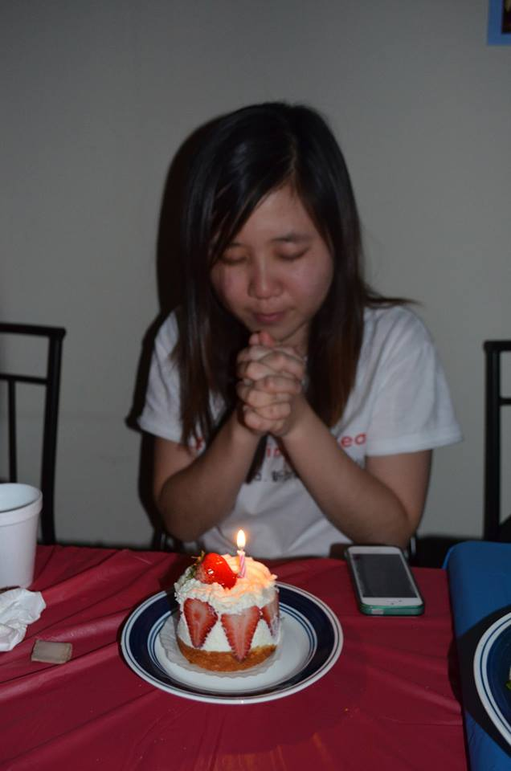
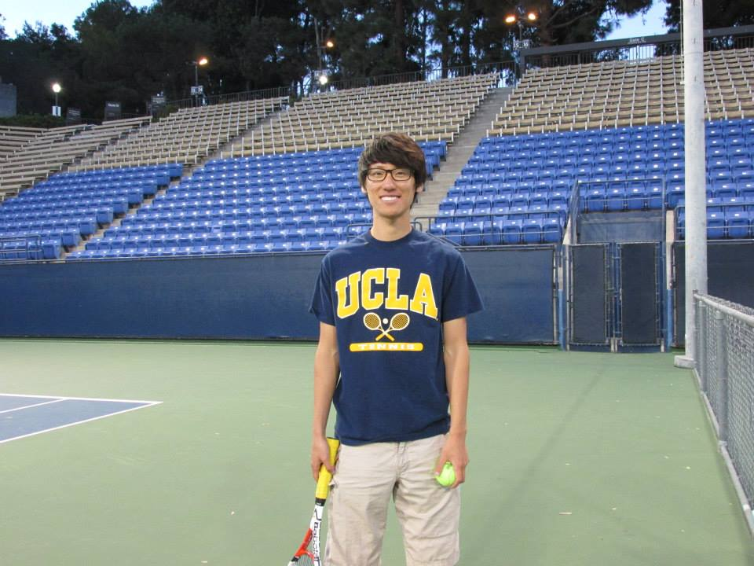
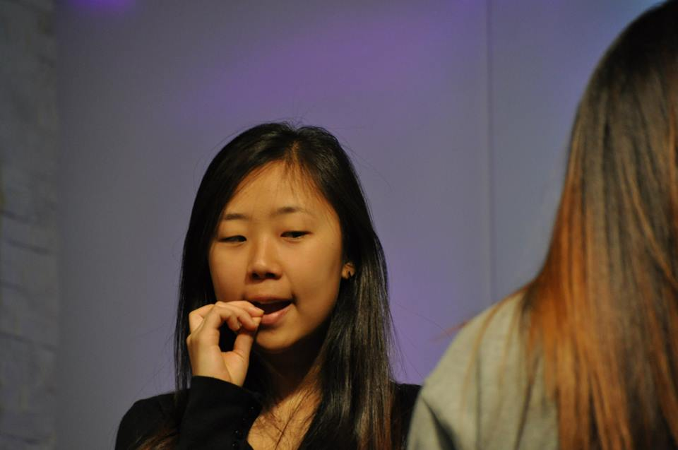
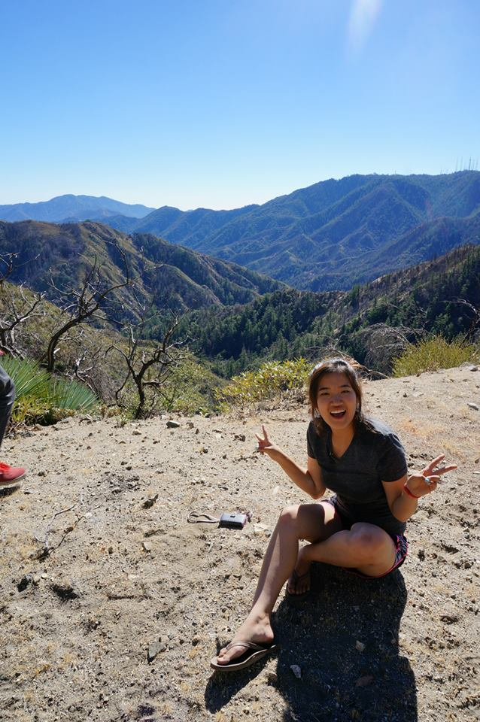
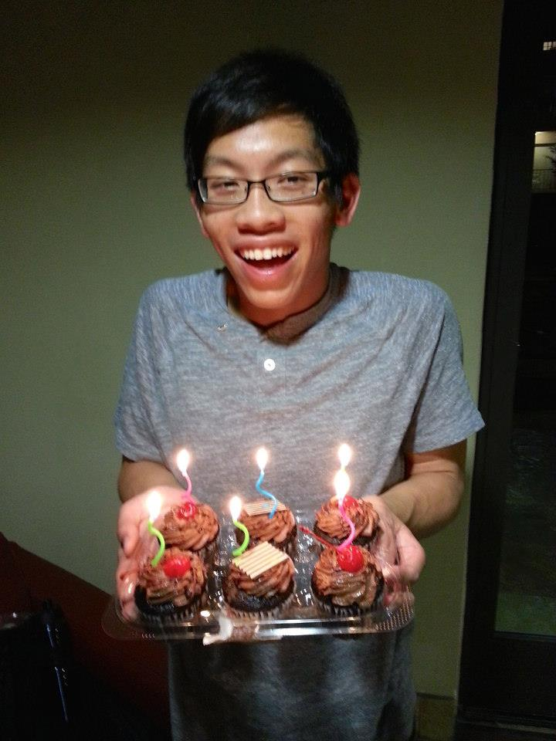
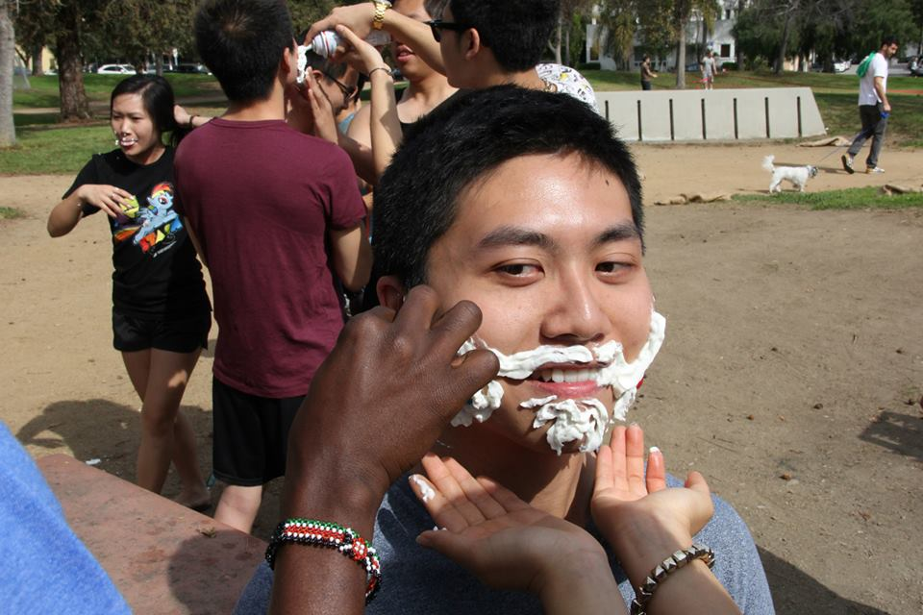


Education Committee!

Slide 27
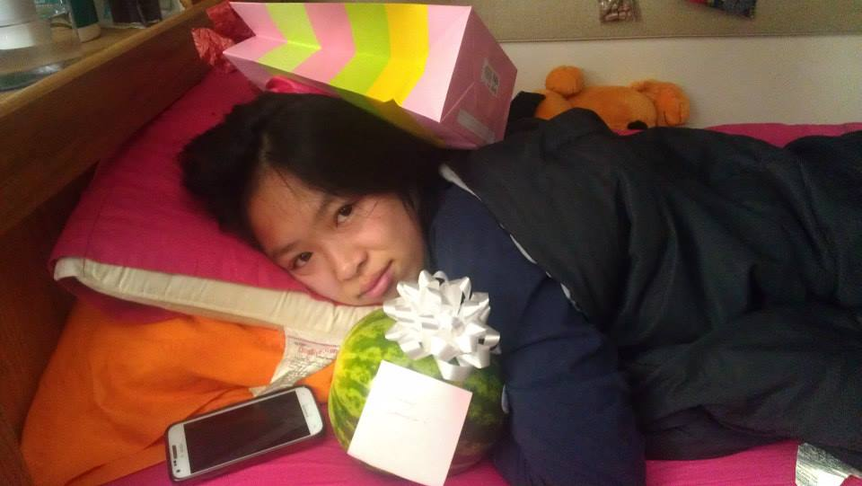

SBotW Committee!
AKA LISA LAU

Slide 28

And ACTIVES!!!
88/110 Good Standing Actives and Associates finished their required hours!!
2661.5 TOTAL HOURS DONE THIS TERM
PATS ON THE BACK FOR ALL OF YOU

Slide 29
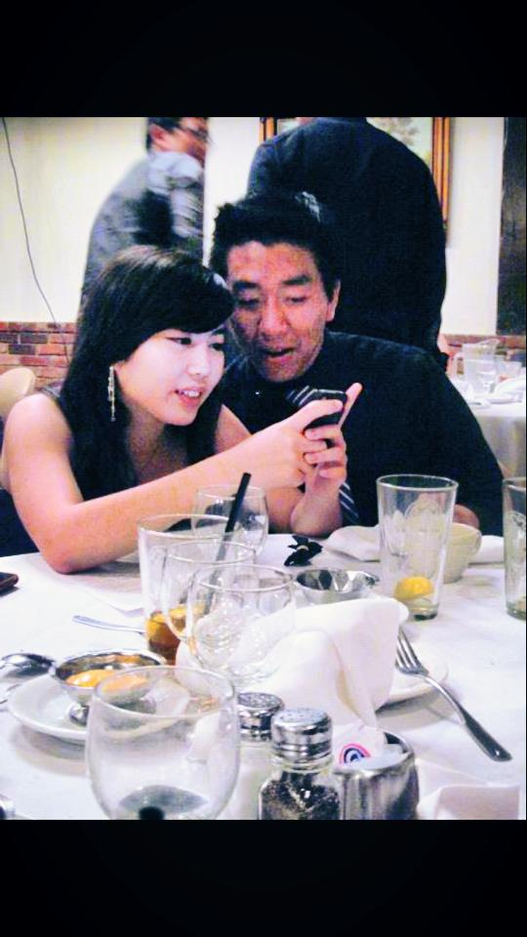

Thank you!
Thanks everyone for a great term!

Slide 30
Pledge Parents
Sean Tran & Annie Tran
pledgeparents@apo-x.org

Slide 31
Alpha Lambda

Slide 32
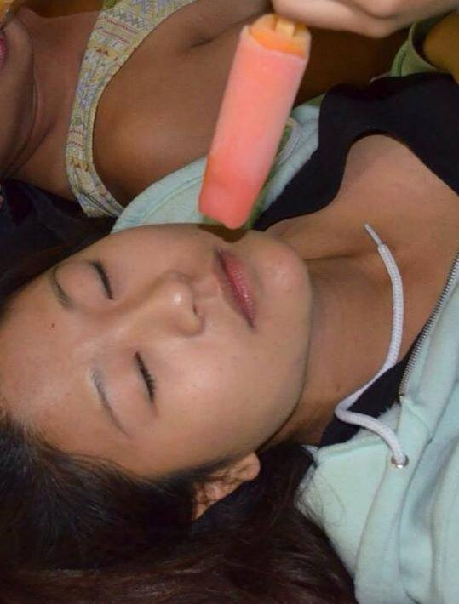
Brothers of Chi Chapter
“My body is ready.”
Submitted by Joseph Chan

Slide 33
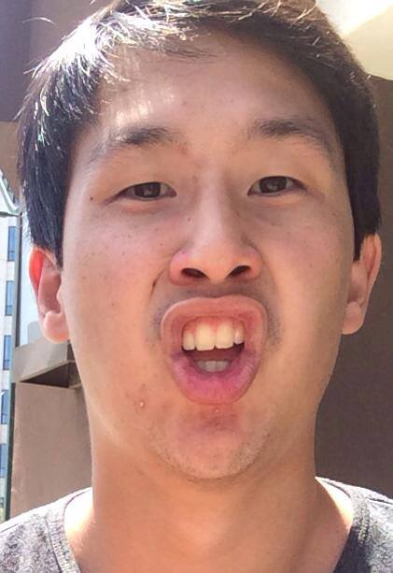
Brothers of Chi Chapter
“Mouth size optimized for Asians.”
Submitted by Jeremy Gozzip

Slide 34
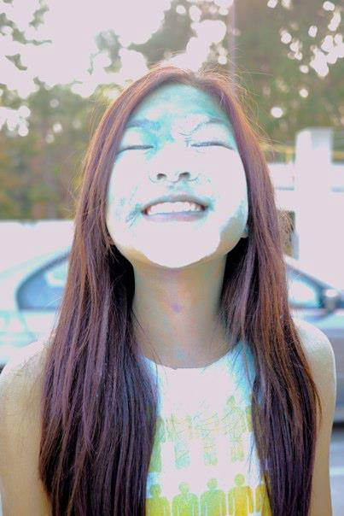
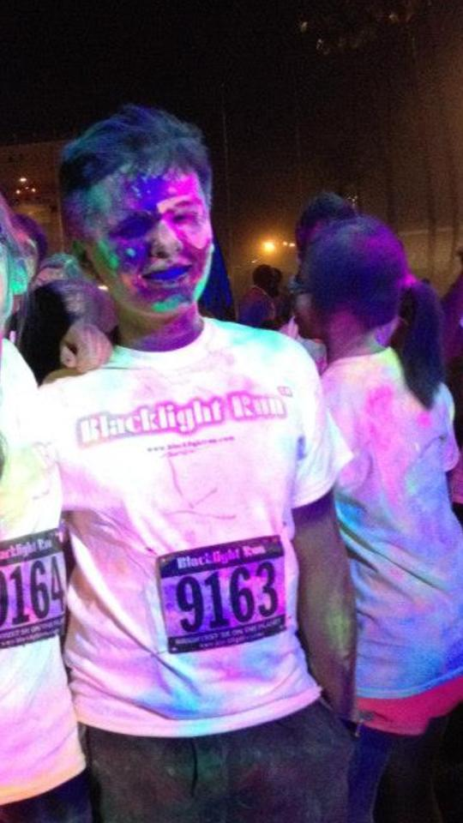
Brothers of Chi Chapter
“Look baby we’re matching.”
Submitted by Nathan Cheung

Slide 35
Finance VPs
Emily Neai-Proeung & Jonathan Liu
finance@apo-x.org

Slide 36
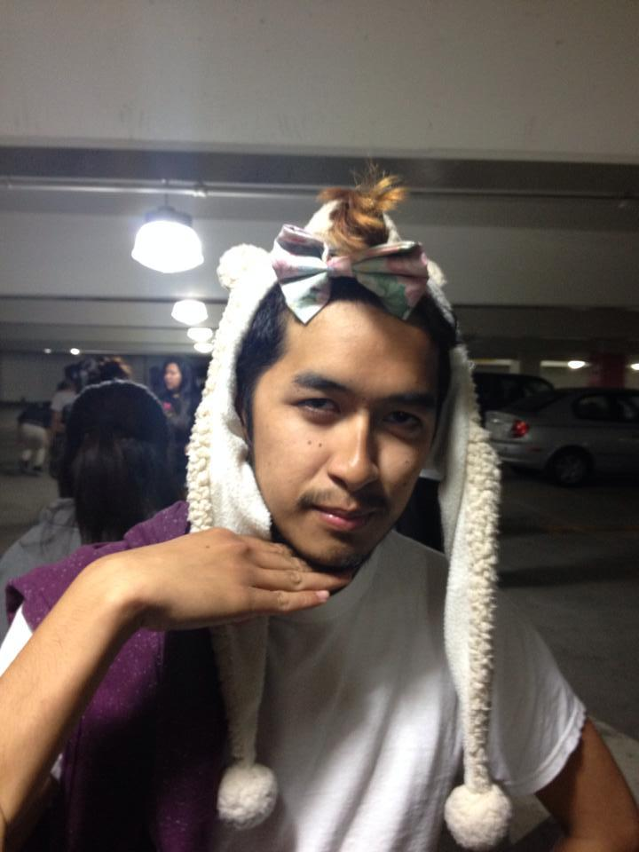
Brothers of Chi Chapter
“Turn down for this.”
Submitted by Andrew Ma

Slide 37
Budget!
Final budget & expense report for the term coming hopefully soon after Finals week!
Under stricter financial constraints the term still went pretty smoothly!
We are currently scheduled to finish the term on a negative budget, more to follow

Slide 38
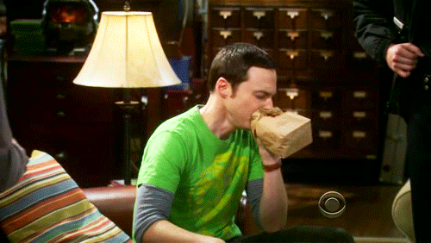

Final fundraising total!
Total fundraised for Autism Speaks:

Slide 39
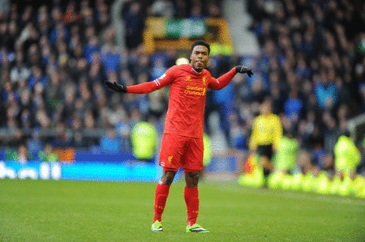

Final fundraising total!
Total fundraised for Autism Speaks: $2336.12!

Slide 40
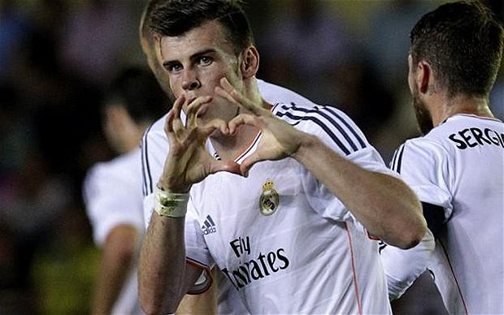

Thanks guyz!

Slide 41
Fellowship VPs
Michael Hung & Dianne Pham
fellowship@apo-x.org

Slide 42
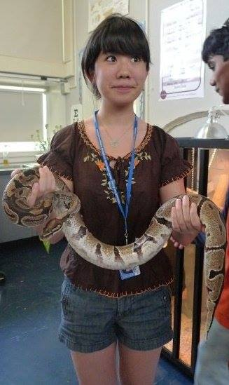
Brothers of Chi Chapter
“This isn’t big enough.”
Submitted by Tin Tran

Slide 43
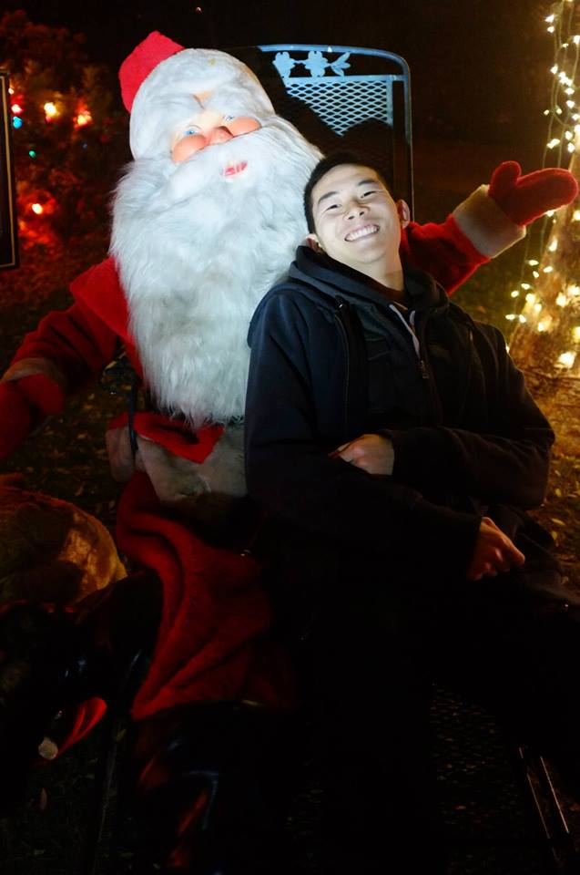
Brothers of Chi Chapter
“First class seat on my lap girl.”
Submitted by Tin Tran

Slide 44
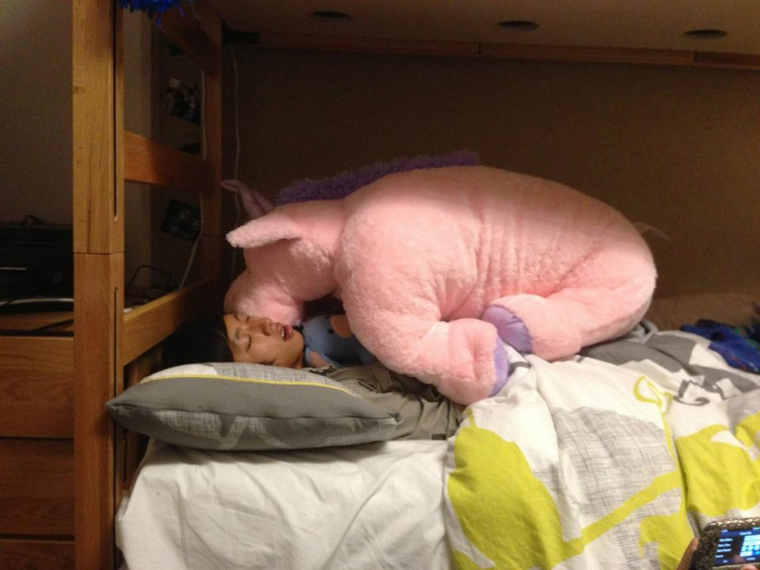
Brothers of Chi Chapter
“No, we shouldn’t! What if Trang finds out?”
Submitted by Michelle Li

Slide 45
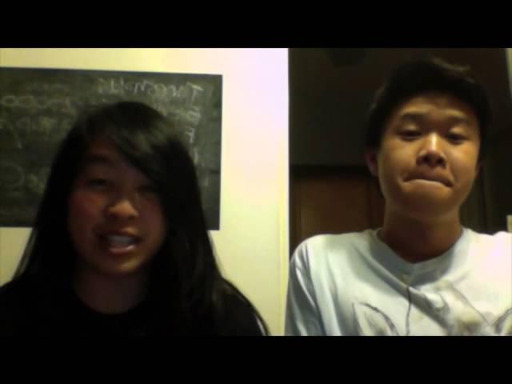

Slide 46

Historian
Tin Tran
historian@apo-x.org

Slide 47
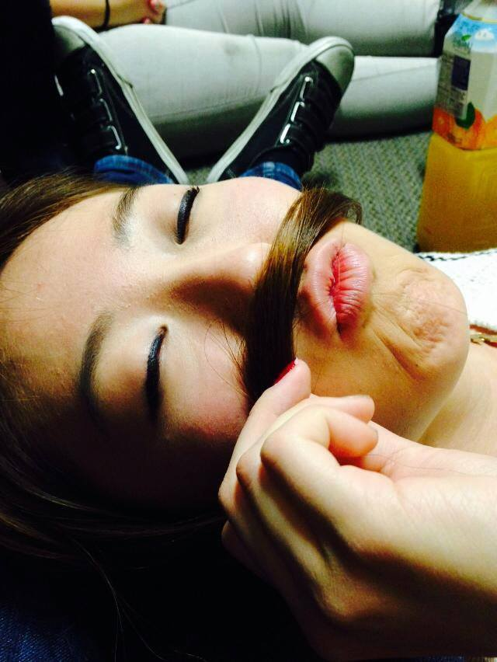
Brothers of Chi Chapter
“I mustache you a question, but I’ll shave it for later.”
Submitted by Nina Zhang

Slide 48

Chi Trivia
What are each family's Colors?

Slide 49
Chi Trivia
What are each family's Colors?
Alphas - Blue
Phis - Green
Omgeas - Red

Slide 50
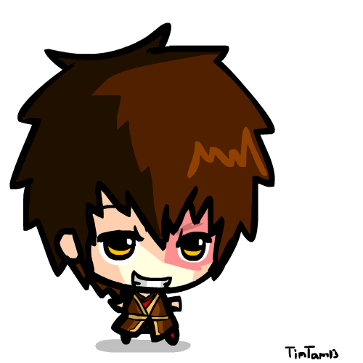
Chi Trivia
What year and at what Chapter did Paul Choung pledge?

Slide 51
Chi Trivia
What year and at what Chapter did Paul Choung pledge?
1997 Gamma Gamma (UCB)

Slide 52


Brother of the Week
DIEEEEEEEEEE!

Slide 53

Brother of the Week
Ann Dai

Slide 54

[YC] Chi Trivia Night
Thanks for coming!
Alphas won...yay!

Slide 55

Headshots...
Last Chapter meeting
Only have less than half of the Chapter’s headshots…
YOU MUST STAY AND TAKE ONE or DAI

Slide 56
Tanks Gaiz
I had fun…
k...bye...

Slide 57
Sergeant-at-Arms
Catherine Teotico
apoxsergeant@gmail.com

Slide 58


Brothers of Chi Chapter
“ “
Submitted by Brian Lee

Slide 59
THANK YOUUU
#THANKS
“ “
Submitted by Brian Lee

Slide 60
Interchapter Chair
Olivia Pardo
interchapter@apo-x.org

Slide 61

WELCOME ADT ^__^

Slide 62

ICDC SHIRTS
Buy buy buy for $5
Cash or venmo
Still got plenty left!

Slide 63

#twotermz
THANK YOU! I LOVE YOU ALL.

Slide 64
Chairman of the Advisory Committee
Kevin Lee
cac@apo-x.org

Slide 66
Nominations
CAC
Paul Choung

Slide 67
Sectionals Chair Nominations
Jeremy Gozzip, Holly Fuong, Dianne Pham, & Bowen Lu

Slide 68
ΑΜ Proposed Active Requirements
•$75 Active Dues by CM2 (Due discount still in effect)
•**Weekly Chapter Meetings** (PROPOSED CHANGE)
•9 out of 12 meeting attendances required
•1 out of 2 election meetings required
•**Leadership** (PROPOSED CHANGE)
•1 Committee
•2 Chairing (PREVIOUSLY 1)
•1 Workshop / Excomm Meeting (PREVIOUSLY NOT REQUIRED) (Allowing excomm meeting to count as a workshop)
•20 hours of Service
•1 Fellowship
•3 Friendships (Fellowship/IC/FAM events after required)
•**Fundraising** (PROPOSED CHANGE)
•$20 (PREVIOUSLY $15)
•2 IC events
•1 Family Event
•3 Chapter Events

Slide 69
Same Requirements
$75 Dues by CM 2 (Due discount still in effect)
Exemplify Leadership, Friendship, and Service
Wear Pin/Letters at all official APO events (Pin mandatory at Service Events.)
2 Rush Events
2 Flyering Hours
20 Hours of Service
1 Fellowship & 3 Friendships
2 InterChapter Events
1 Family Event
3 Chapter Events

Slide 70
Chapter Meetings (Proposed Change)
•Weekly Chapter Meetings
•9 out of 12 meeting attendances required
•1 out of 2 election meetings required

Slide 71
Leadership (Proposed Change)
•1 Committee
•2 Chairing (PREVIOUSLY 1)
•1 Workshop / Excomm Meeting (PREVIOUSLY NOT REQUIRED) (Allowing excomm meeting to count as a workshop)

Slide 72
Fundraising (Proposed Change)
•$20 Fundraising (Previously $15)

Slide 73


